Slide 1

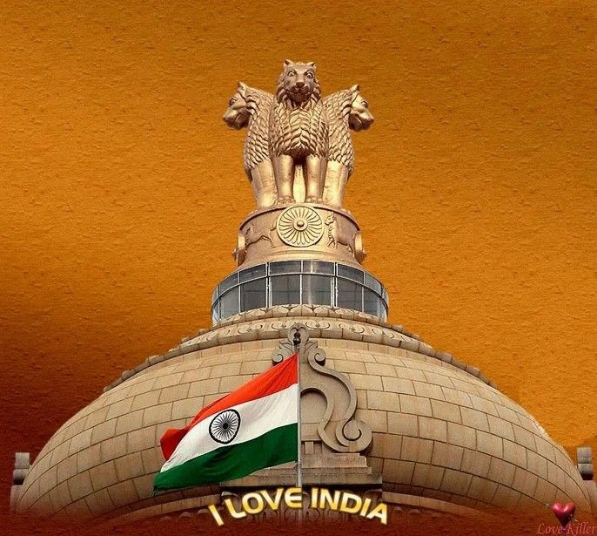
E-Voting System
PROJECT GUIDE: SUBMITTED BY,
MR.SANTOSH MALI(TRAINER) NITHIYASRI.S (EBEON0721403890)
BRINDHA.S (EBEON0721402706)

Slide 2
CONTENTS:
INTRODUCTION
EXITING SYSTEM
PROPOSED SYSTEM
FUNCTIONALITIES
REQUIREMENTS
MODULES
TOOLS
ADVANTAGES
CONCLUSION

Slide 3
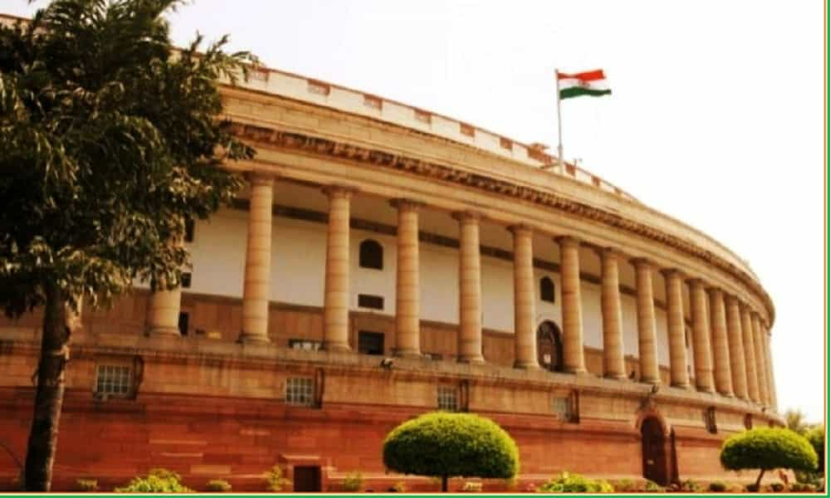
Introduction:
The E-Voting project is an online voting system through which the citizens can vote from anywhere who were not be to able to participate in voting system due to any reasons.
Our Moto is to achieve maximum participation in voting system. The Candidate have to register first by Using Sign-Up portal.
Then the registered user will able to access the Home-page and use the various functions like Voting, Survey, Parties profile etc.
Candidate Authentication using Voter-ID and UID, Verification using OTP, Voter privacy, Voting security, Quick notification.

Slide 4


EXISTING SYSTEM:
In existing system, if you wish to vote for someone, then you have to go to the destination where the voting procedure is going on and then only you can vote for him or her.
Existing system does not provide people the way in which they can get the details about the nominees as well.
They can’t get to know the history of the people for whom they are standing in queue for giving their votes.
The problems of the existing manual system of voting include among others the following:
Expensive and Time consuming
Too much paper work
Errors during data entry
Loss of registration forms

Slide 5
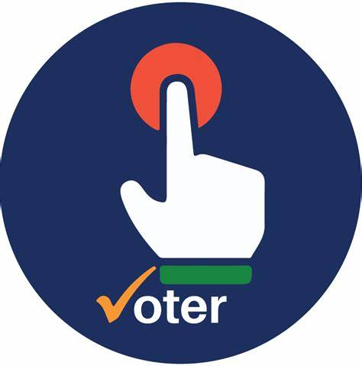


PROPOSED SYSTEM:
Proposed system is highly automated and greatly technical. In this system, not even you can vote via sitting at your own place but also you can learn about laws regulations related to voting.
Also not only this but you can access the profile of the nominee's through which you can learn about their history, their education, and their personal details and so on.
Using this online voting based project, end user do not faces any difficulties as because they don’t have to make registration before submitting their answer.

Slide 6
FUNCTIONALITIES:
The Specific functions of the projects include:
Reviewing the existing/current voting process.
Coming up with an automated voting system.
Implementing a automated/online voting system.
Validating the system to ensure that only legible voters are allowed to vote.

Slide 7
REQUIREMENTS:
Registration of the voter is done by ELECTION AUTHORITY
ELECTION AUTHORITY can change the information any time if required.
Registration of the voter depends upon the information filled by user manually to the ELECTION AUTHORITY.
Voter is given a unique login ID and PASSWORD.
In the DATABASE information of every voter is stored.
DATABASE shows the information of every use.

Slide 8

MODULES:
All modules developed by S.Nithyasri.
Voter Module:
In this module, user who is going to give his or her vote have to make his or her account in order to get access to the voting system and into the modules which contains details about the nominee’s.
Admin Module:
Admin checks the data and valid voter admin also gives the results once the voting is conducted. Only admin is authorized to check the results.
Voting Module:
In this module, all the process related to voting and voters are given onto this module. Voters can access to this module via their personal account only.

Slide 9


TOOLS (TECHNOLOGIES):
Hardware Requirements:
System processor - AMD PRO A4
Hard disk - 64 GB
Monitor - “15’’ LED
RAM - 4 GB
Software Requirements:
Visual studio code
Language: HTML, CSS, Java Script
Google Chrome

Slide 10

ADVANTAGES:
Fast and easy way of conducting elections
Voter can view background of each candidate.
Candidate can present themselves against voters.
Admin can verify the documents and details of candidate.
System generated Unique ID and password gives more secure logins.
Results will be out after 2Hrs of election.

Slide 11
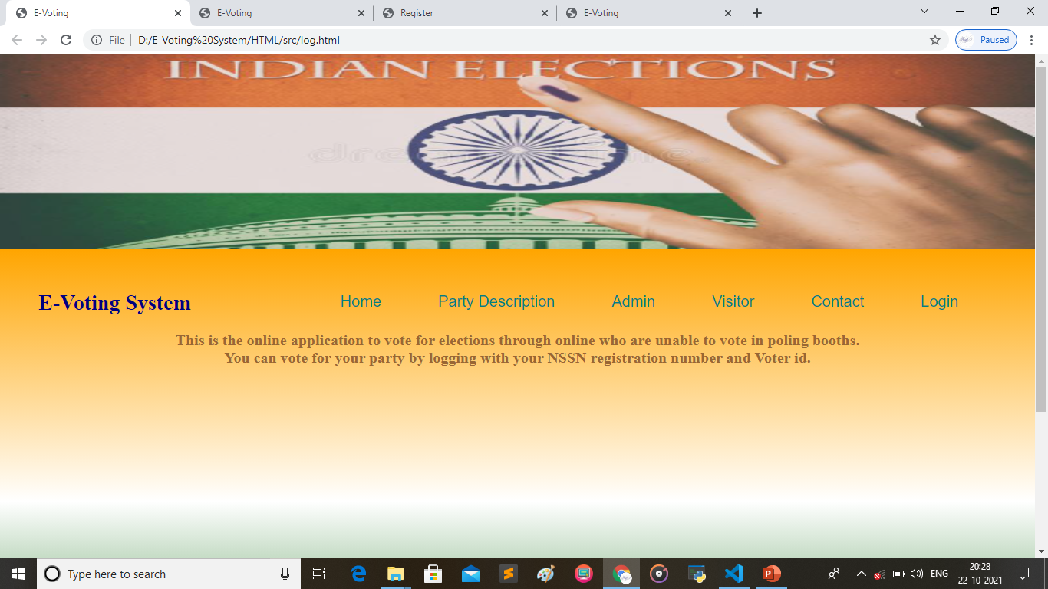
Front page:

Slide 12
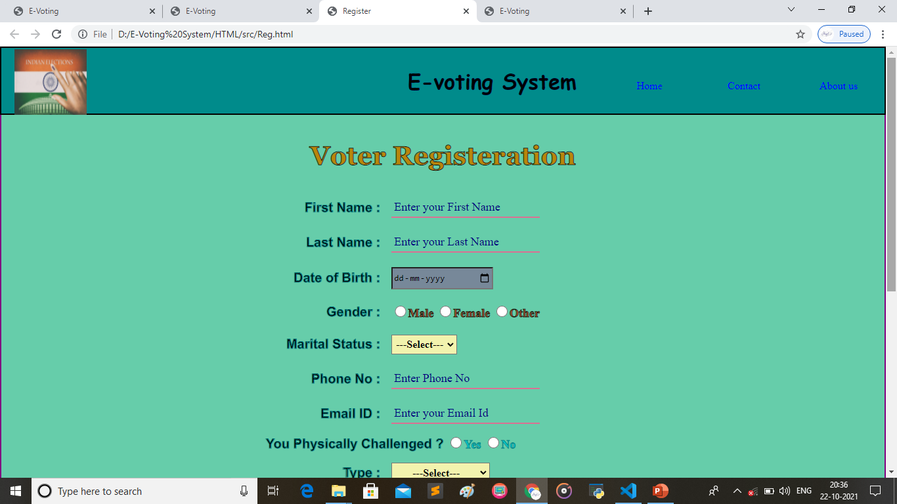
Registration page:

Slide 13
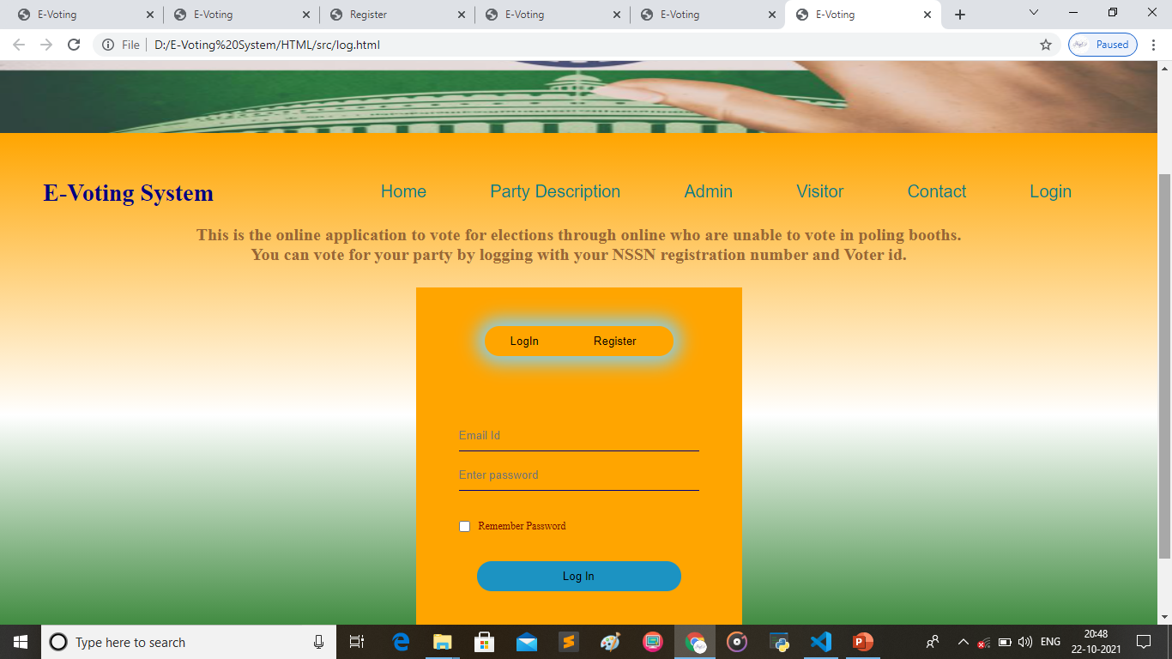
Login page:

Slide 14
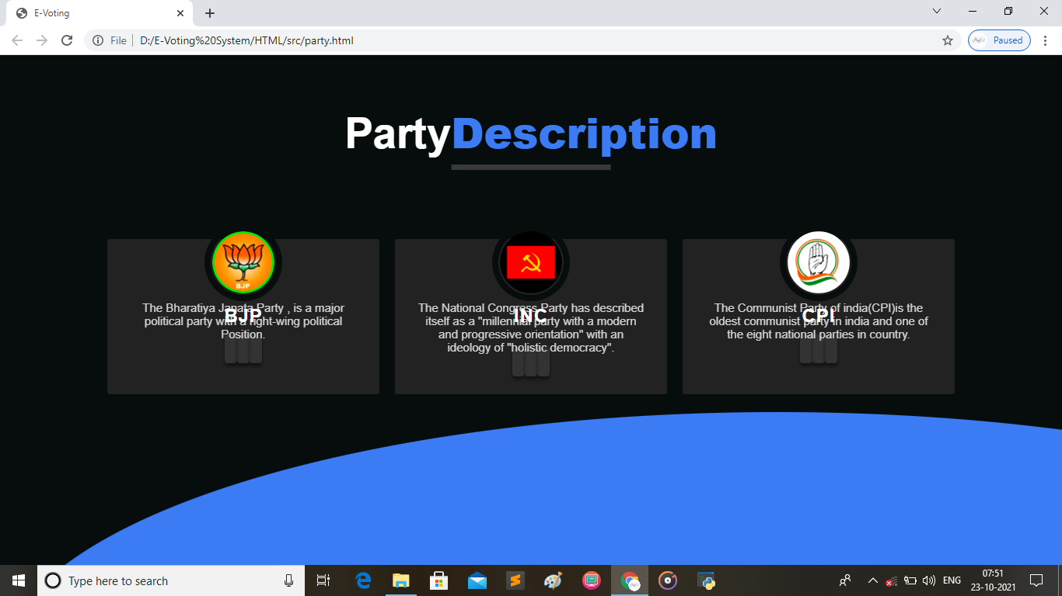
Party Description:

Slide 15
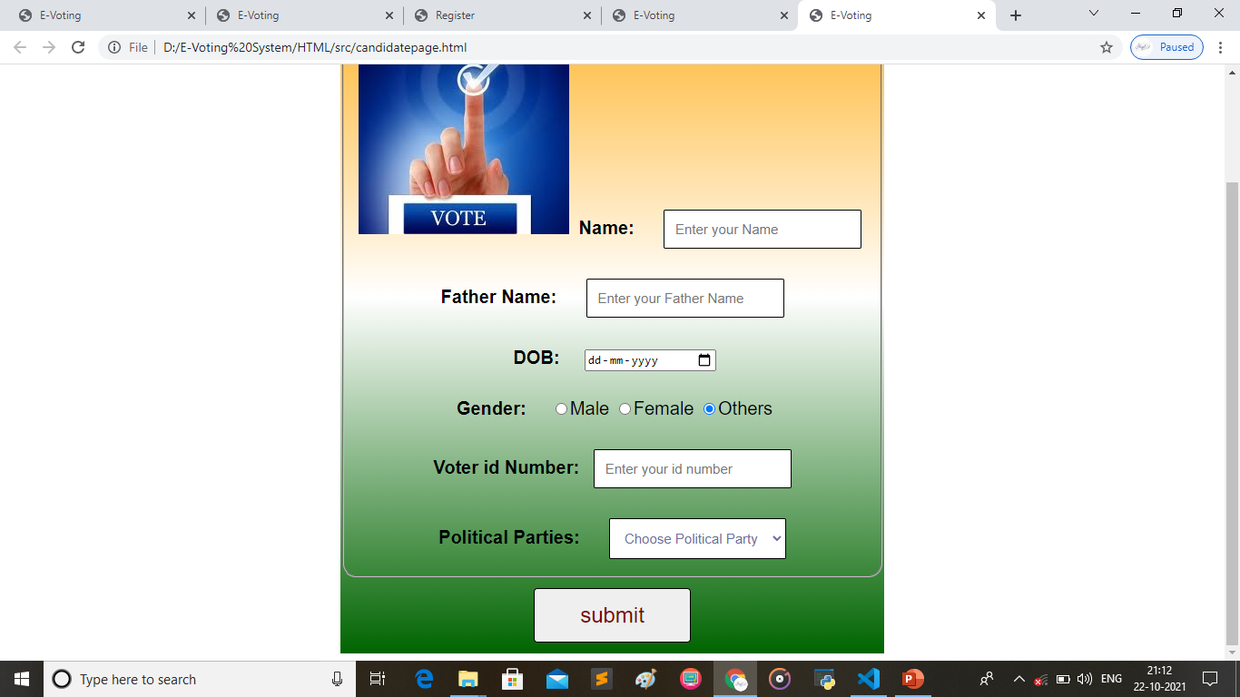
Voting page:

Slide 16
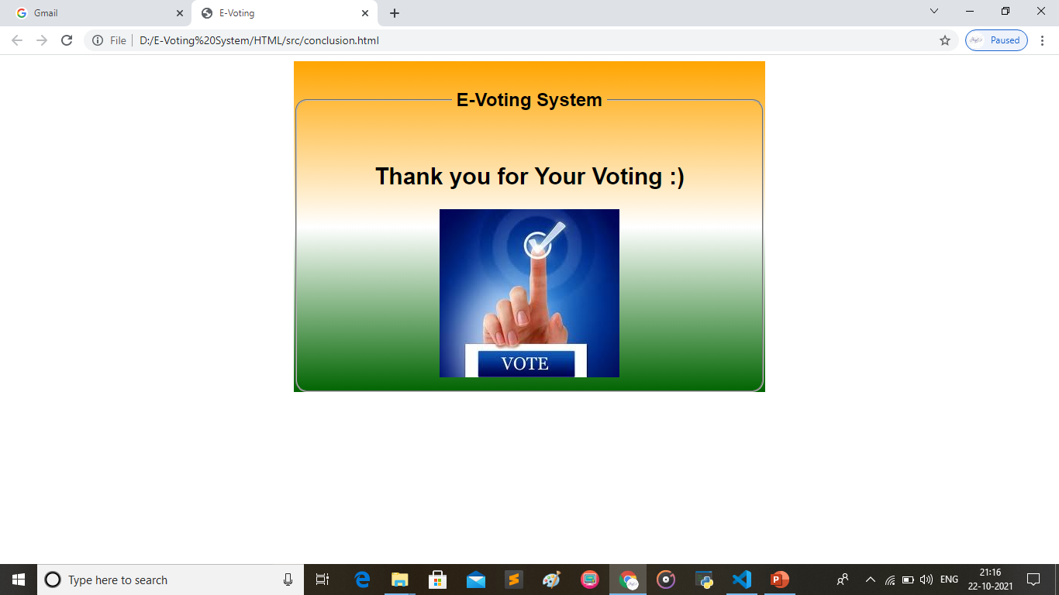
Submit page:

Slide 17
CONCLUSION:
Maximum participation in voting will be done in future as we all are in the digital era.
Advertisement of the parties will also be managed easily which will reduce the cost of campaigning.
No need for extra booth for handling the crowd which will reduce the cost of security for Election committee.
The candidates who are not able to vote by going to the booth because of their physical or other issues will also be able to give their participation.
The notification related to Election or Voting issue will be sent easily to the candidate by using SMS and Email system.

Slide 18
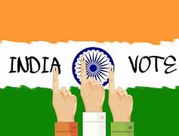
THANK YOU…

